Slide 1
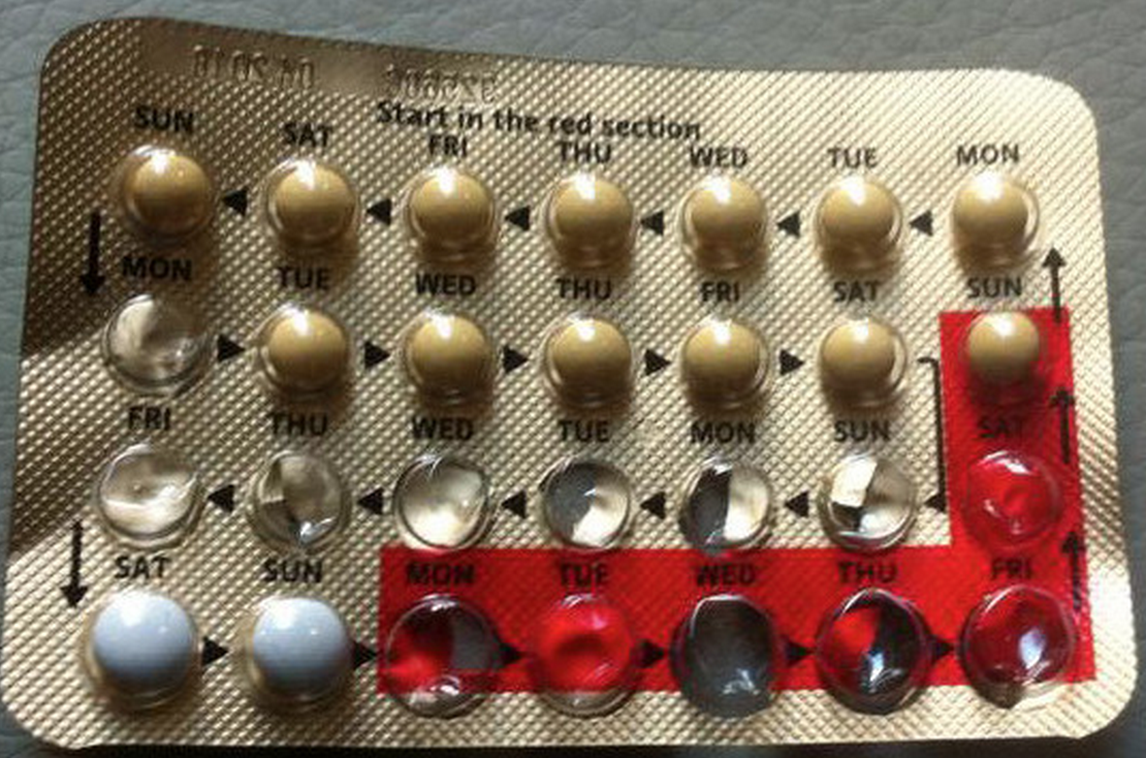
What is does USABLE mean?
Does it do what the user wants?
Does it do what the user expects?
(NOT what YOU expect)
Notes:
Functional view
You are not your user

Slide 2
Kinds of User Testing
Formative Evaluation
  Iterative testing during the design process to help find and fix usability problems. Usually, bring users to lab.
Field Study
Controlled Experiment
Notes:
Functional view
You are not your user

Slide 3
Roles: Basic Setup
Roles:
Facilitator briefs user, provides tasks.
User should perform tasks, think out loud
Observer take notes. NO active participation
  Not seen or out of the way
How do you choose tasks for the user to complete?
How do you understand user behavior?
How do you create a comfortable user experience?

Slide 4
Pre-Test Questionnaires
Learn any relevant background about the subjects
Age, gender, education level, experience with the web, experience with this type of website, experience with this site in particular,
Perhaps more specific questions based on the site, e.g. color blindness, if the user has children, etc.
(from Jennifer Golbek, University of Maryland)

Slide 5
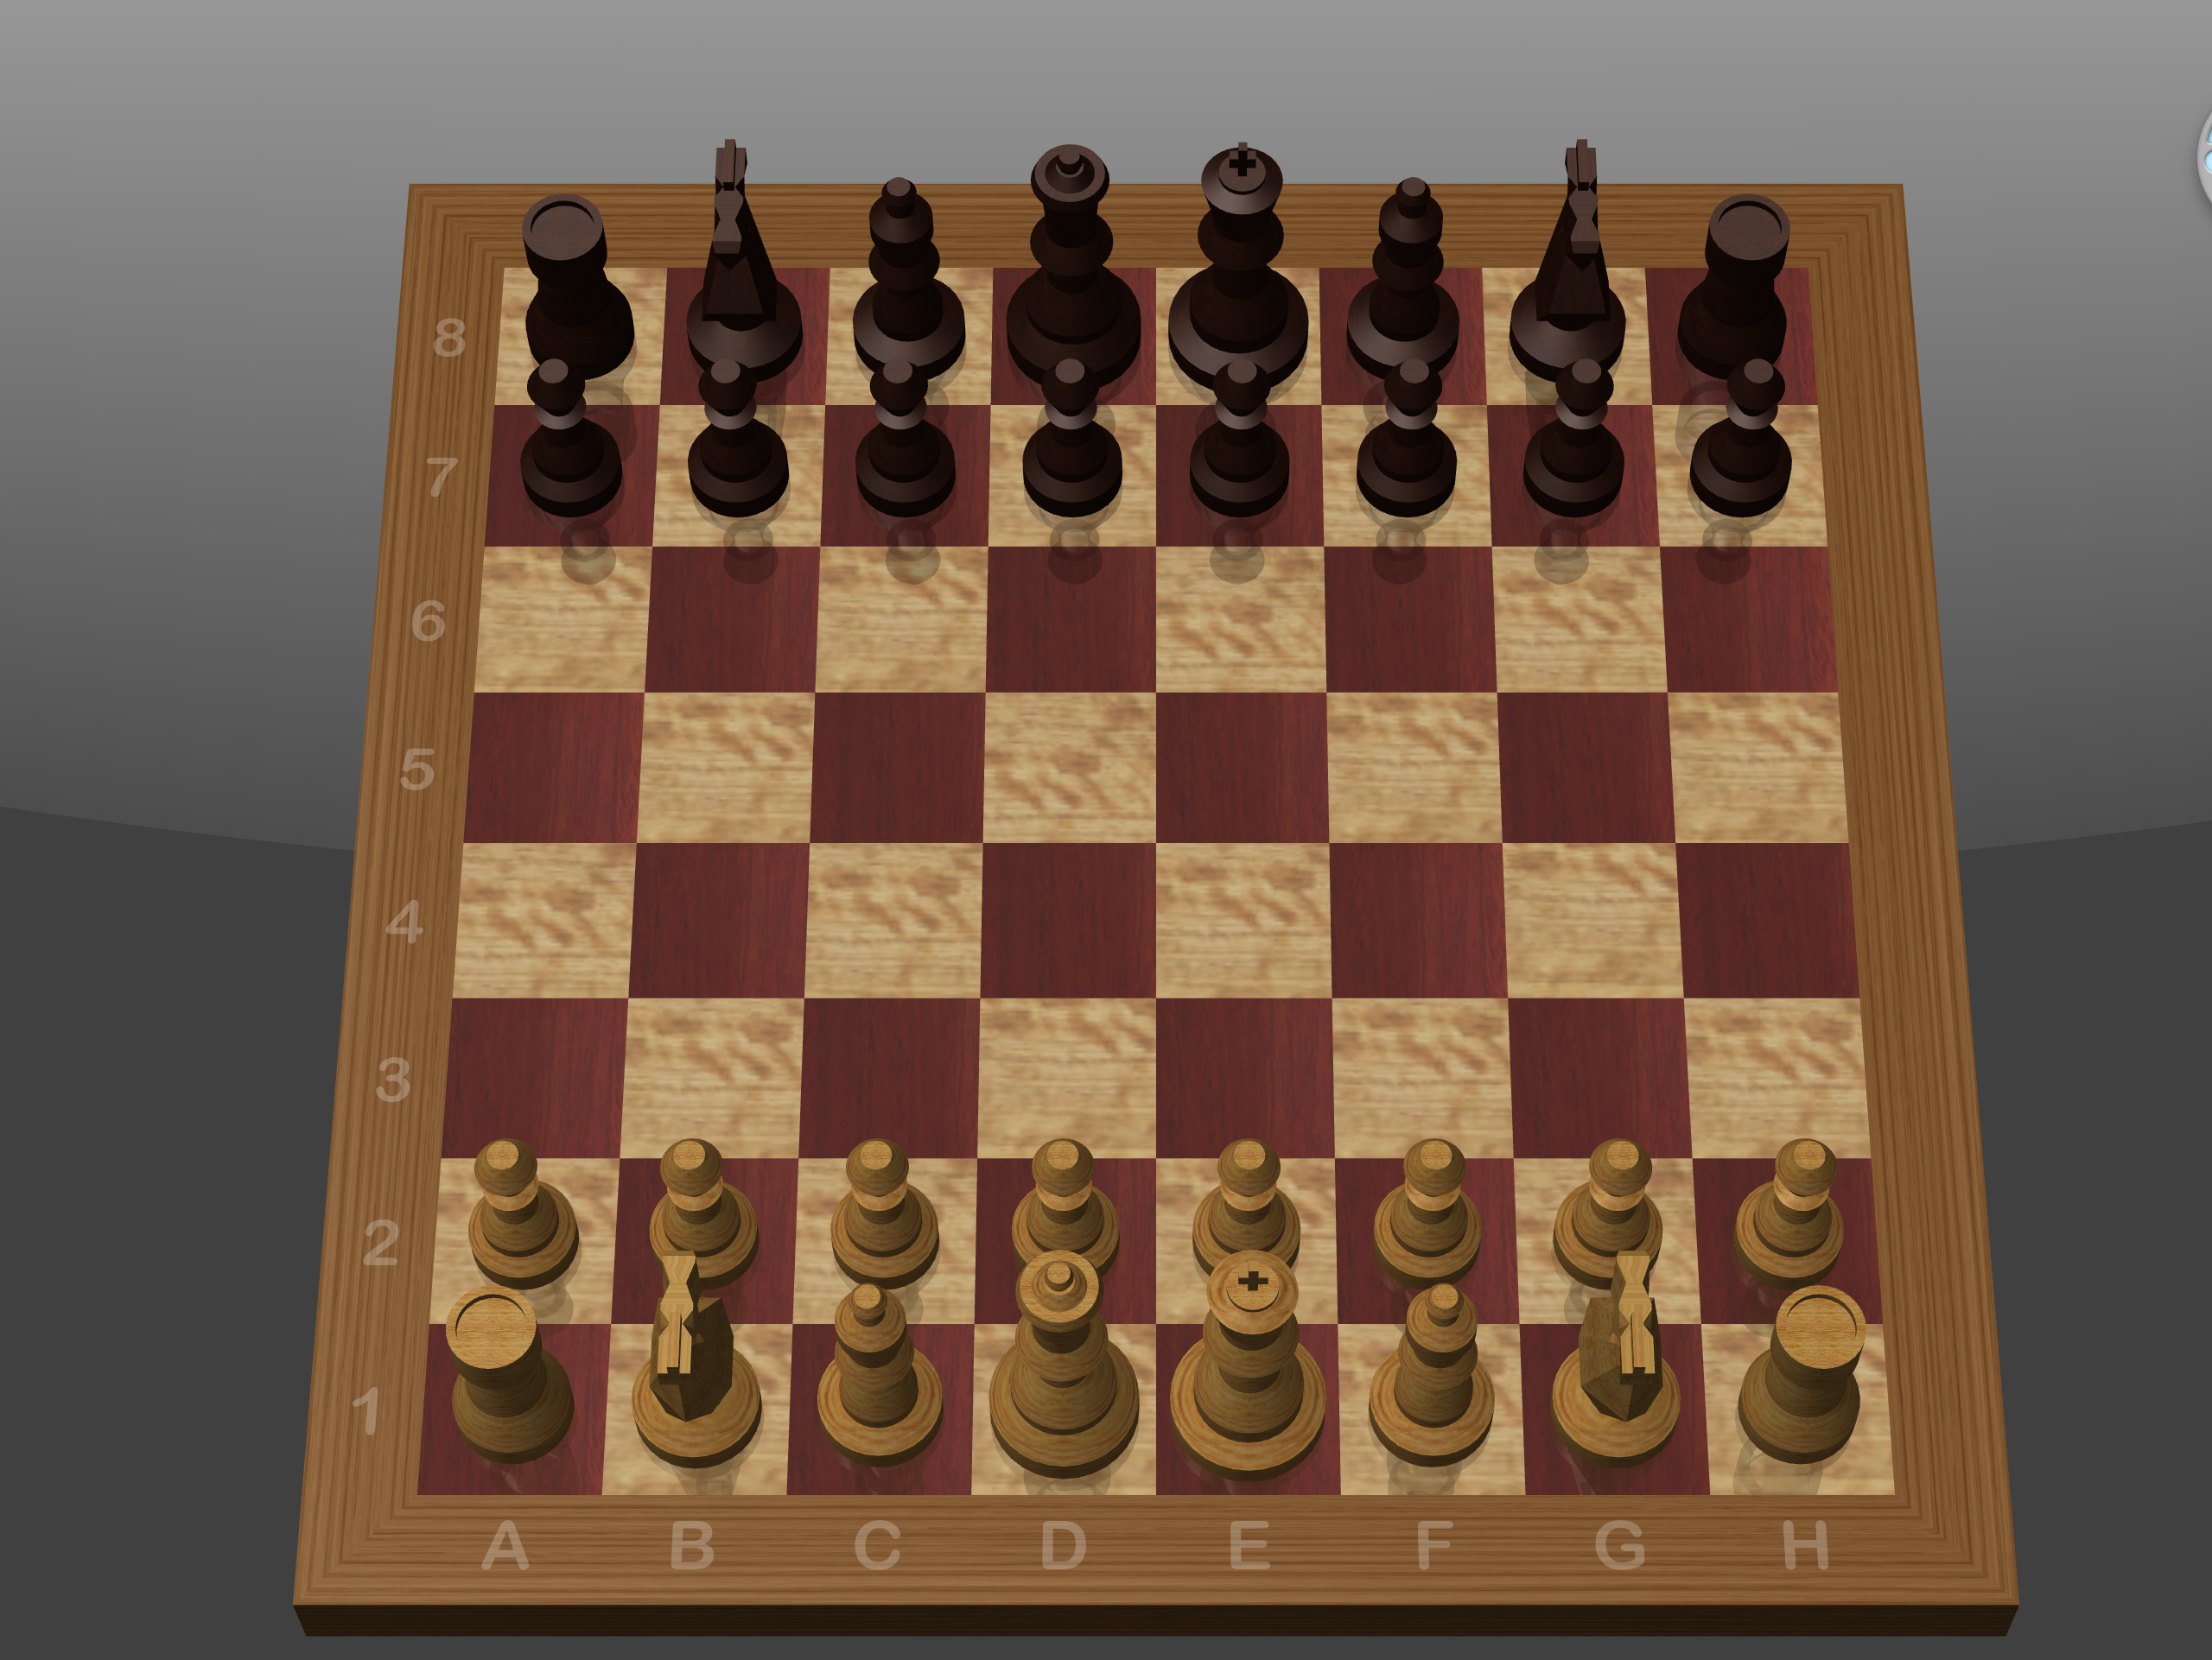
Who wants to test Chess?

Slide 6
Write some tasks

Slide 7
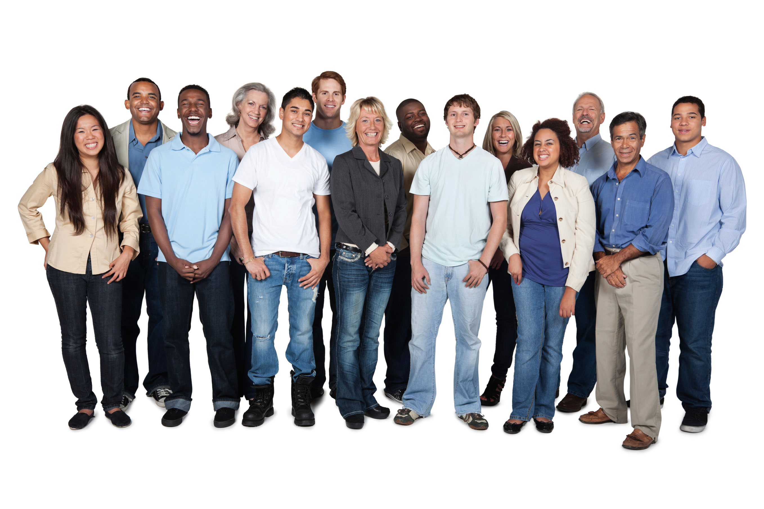
Users are People
Has performance anxiety
Is worried he’ll perform poorly compared to other testers
Feels stupid using a computer in front of others

Slide 8
How do we help users?: Before
Inform them
  What is the study about?
  What happens with the recorded data?
Framing
  We’re testing the system, NOT YOU
  It’s the system’s fault, not yours

Slide 9
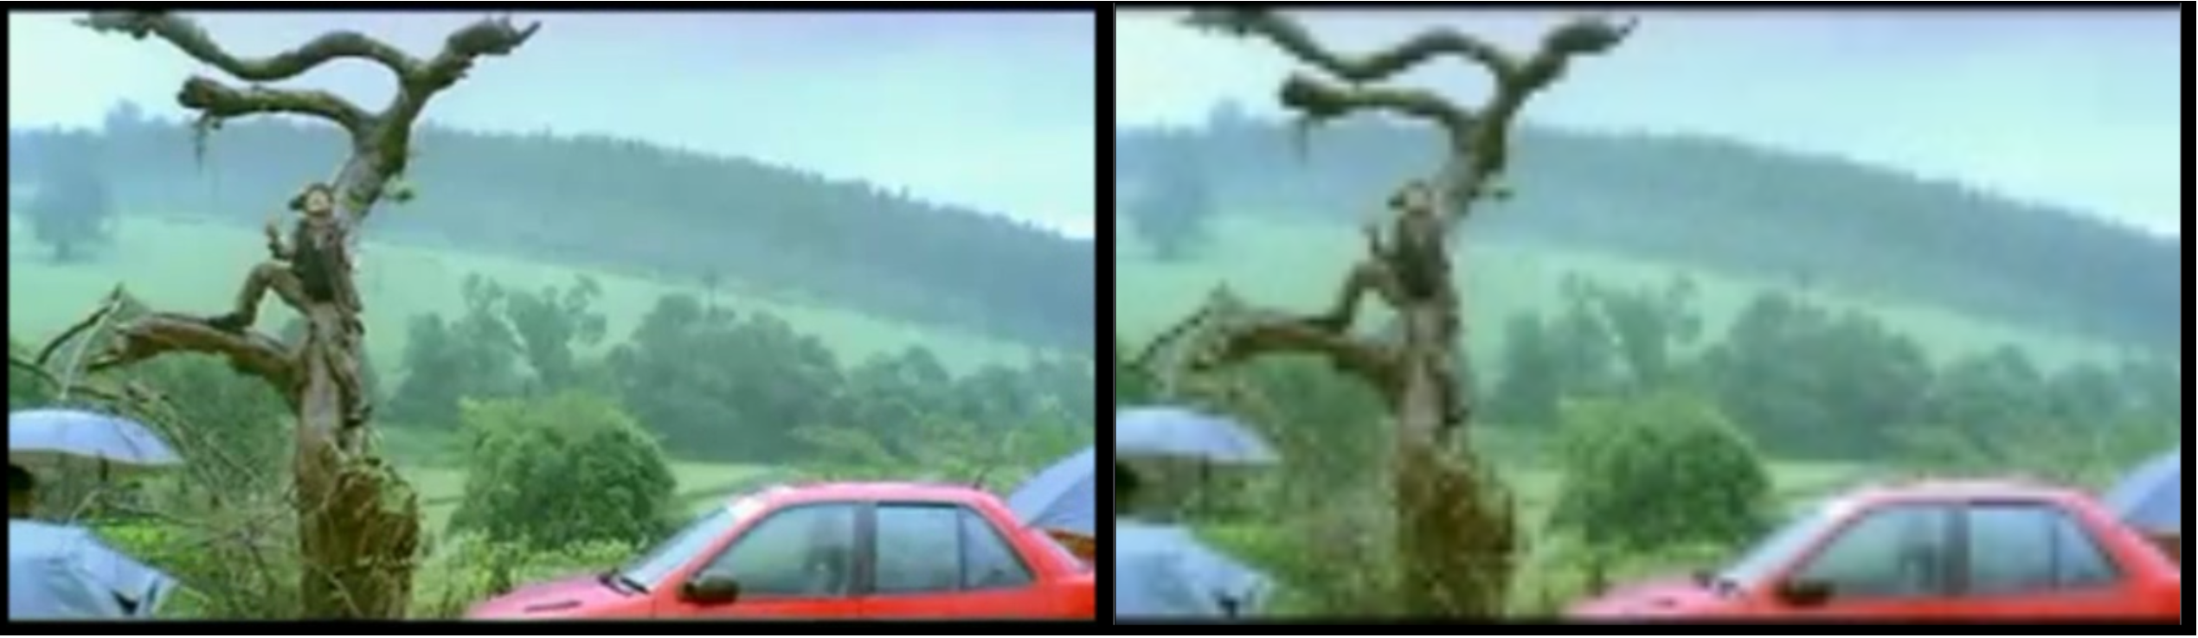
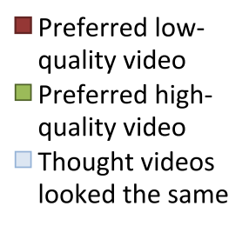
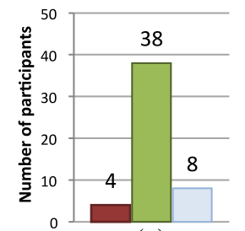
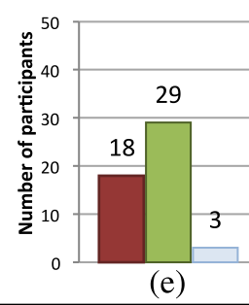
Response Bias
“This phone uses a new player”
“This phone uses MY new player”
Dell, N., Vaidyanathan, V., Medhi, I., Cutrell, E., & Thies, W. “Yours is Better!” Participant Response Bias in HCI. In CHI 2012.

Slide 10
How do we help users?: During
Inform them
  Answer questions (as much as possible)
Framing
  Never act disappointed
  Start with an easy task
Privacy
  Don’t let random people watch
Comfort and Control
  Take breaks
  User can quit any time

Slide 11
Click-and-drag a pawn one square ahead

Slide 12
Define Tasks: Don’t say HOW
Click-and-drag a pawn one square ahead
Move a pawn one square forward

Slide 13
Can the knight on G2 move to H3 or G3?

Slide 14
Define Tasks: Avoid Questions, Use Tasks
Can the knight on G2 move to H3 or G3?
Make a legal move with a knight

Slide 15
Finish up your game

Slide 16
Define Tasks: Be Specific
Finish up your game
Exit the application without saving

Slide 17
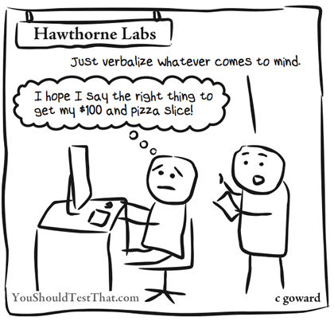
Think-Aloud Protocol
Kinds of questions:
  What do you think is happening?
  What are you trying to do?
May modify interaction
Two people work together
  Conversation is natural
  But may not work together
Notes:
Does someone have Chrome?
Change the default download location of your browser.

Slide 18
Summary
Typical set up: user, facilitator, observer(s)
Be careful in your task selection and crafting
  MAKE A SCRIPT!
  Give tasks, not questions
  Be clear and specific
  Don’t over-instruct. Give realistic tasks
  Be careful not to bias
Consider the human element
  Capture information with questionnaire
  Make the user feel as comfortable as possible
    How you frame the experiment
    Your environment
  Consider how think-aloud impacts interaction

Slide 19
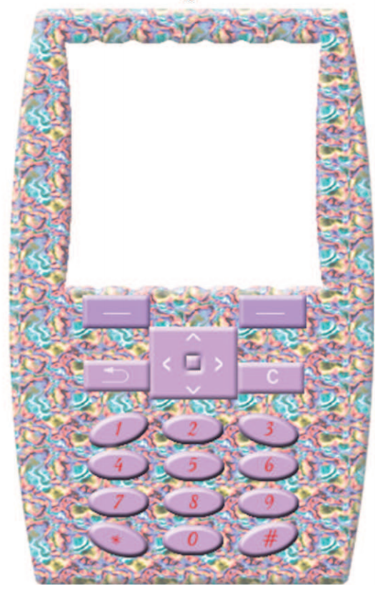
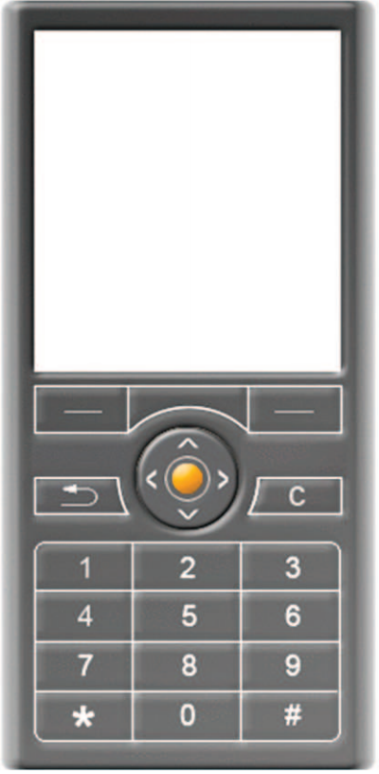
What have we missed?
1
outperforms
2
Notes:
Honda story

Slide 20
EMOTION
1
outperforms
2
How do you capture the user’s full experience?
Notes:
Honda story

Slide 21
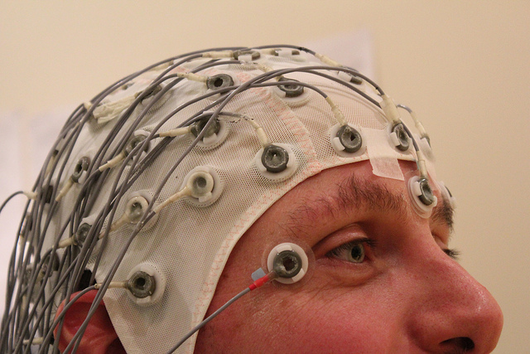
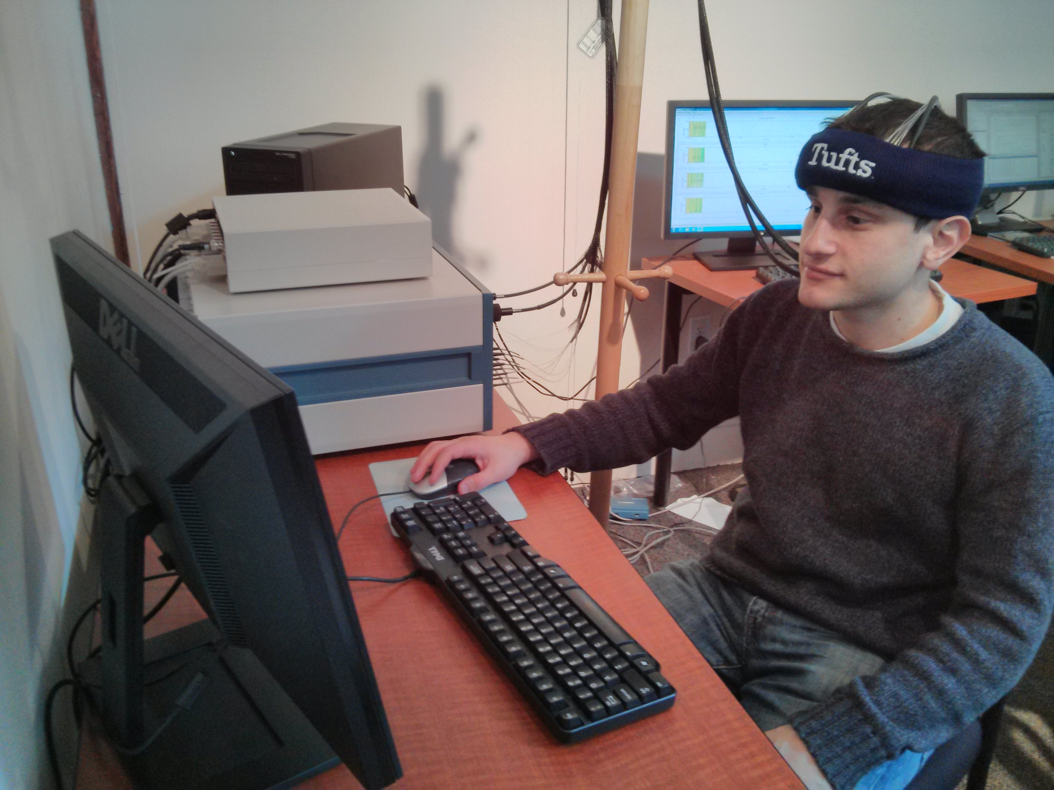
What’s next?
Emerging technology
  Eye-tracking
  Heart rate monitor
  Brain sensing
Not reliable yet, but not as far out as you think!
Are there new ethical issues?

Slide 22
Summary
Typical set up: user, facilitator, observer(s)
Be careful in your task selection and crafting
  MAKE A SCRIPT!
  Give tasks, not questions
  Be clear and specific
  Don’t over-instruct. Give realistic tasks
  Be careful not to bias
Consider the human element
  Capture information with questionnaire
  Make the user feel as comfortable as possible
    How you frame the experiment
    Your environment
  Consider how think-aloud impacts interaction
Consider what your tasks might not capture
  User experience: does it make them feel cool?
Thanks to Rob Miller (CSAIL at MIT), Terry Winograd (Stanford), Jennifer Golbeck (University of Maryland)

